Slide 1
Construction Program Update EEO and DBE
Brad Jones, Deputy Director, Division of Construction
Marci Wright, Administrator
Office of Small and Disadvantaged Business Enterprise

Slide 2
Construction Program Update
DBE Update
New DBE Rule
Good Faith Efforts (PN 013)

Slide 3
DBE Update
Program Performance
DBE New Rule
Business Development
Capacity Building Program - APB
Mentor-Protégé Program
Supportive Services
Good Faith Efforts

Slide 4
DBE New Rule effective - 11/3/2014
Certification
New business size standard not to exceed $23.98 Million
New personal net worth form with new information requested
Primary activity declared
Codes verified by certifying agent

Slide 5
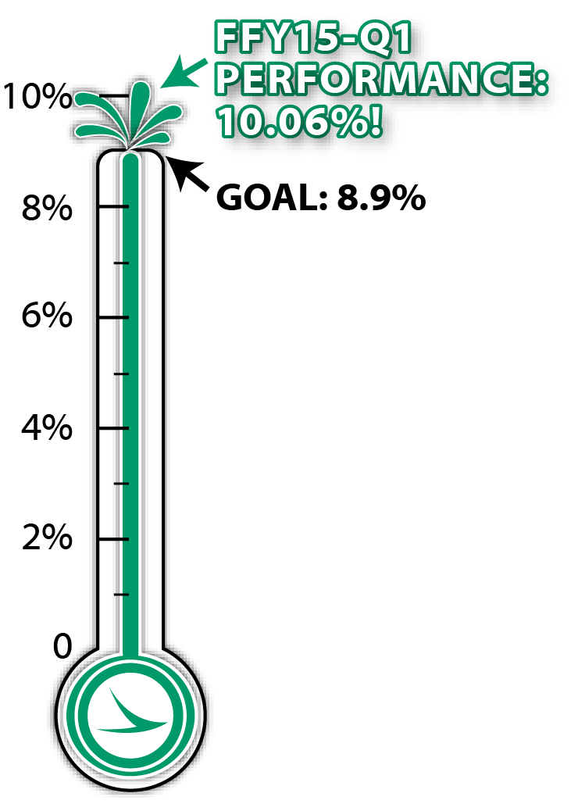
DBE Program Goal Performance
Goal Thermometer
For Federal Fiscal Year 2015, First Quarter (10/1/2014 – 12/31/2014) Ohio’s overall DBE Goal was 8.9%... Our actual performance was 10.06%!

Slide 6
What’s new in ODOT’s DBE Certification Program
DBE Directory new location transportation.ohio.gov/dbe
Ethnicity and gender included
Prequalification status included
List may be exported and sorted

Slide 7
Proposal Note 013
Bidders must submit names and addresses of DBE firms that will participate
Breakout session today with Tina Collins 4 p.m.
Bidder’s commitment to use DBEs listed
Confirmation from DBEs
Documentation of Good Faith Efforts if goal is not met
Good Faith Efforts 49 CFR Part 26.53
Notes:
This does not change responsibility of assigning NAICS Code from UCP or State DOT. DBEs and primes must be aware of NAICS Codes—look on the Directory– and include the NAICS Code on its commitment form. Must include what the DBE will perform on the contract. Having a written commitment from the DBEs is not new.

Slide 8
Assurances 26.13
Failure by contractor to carry out these requirements is a material breach. . . which may result in the termination of this contract or other remedy as the recipient deems appropriate, including, but not limited to:
Withholding progress payments
Assessing sanctions
Liquidated damages
Disqualification from future biddings
Notes:
Adds examples of remedies recipient may deem appropriate. For those of you who have inquired as to when contract documents must be changed to incorporate these changes, all I can say is work with your Division to implement these changes as soon as possible.

Slide 9
Proposal Note 013
Firm must use committed DBEs unless firm receives State’s written consent
If a firm terminates or replaces DBE without consent, prime not entitled to payment for work performed
Notes:
NPRM proposed to eliminate “responsibility” option. The Department was concerned about allegations by DBEs of “bid shopping” that occurred after the low bidder was identified but before the low bidder was required to submit its DBE commitments. However, after considering the large number of comments that came in on this issue, and the desire to keep the program flexible, the Department chose to address the bid-shopping concern by limiting the number of days the low bidder has to submit its commitment. We did a survey of DBE program plans to determine the average number of days States allowed for low bidders to submit commitments and determined that 5 was reasonable. To allow States time to adjust, we are allowing 7 days until January 2017

Slide 10
Proposal Note 013
When a DBE is terminated or replaced –with permission– or fails to perform work, State must require prime to make good faith efforts to find another DBE to perform at least the same amount of work needed to meet the contract goal
If State requests documentation, prime must submit within 7 days and recipient shall provide written determination of sufficiency of GFE

Slide 11
Appendix A—Good Faith Efforts
ODOT’s Efforts in Reviewing and Evaluating Good Faith Efforts
Must review performance of other bidders
Must require contractor to submit copies of each DBE and non-DBE subcontractor quote where a non-DBE was selected over a DBE due to price
Contact DBEs listed to confirm they were actually contacted by prime

Slide 12
Appendix A—Good Faith Efforts
Negotiating in good faith; specifying work considered for DBEs; explaining why agreements could not be reached
Not rejecting a DBE quote because it was not the lowest received as long as the quote was reasonable
May not reject a replacement DBE if unable to find a DBE at the original price

Slide 13
Appendix A—Good Faith Efforts
Efforts may include:
Conducting market research and solicit through all reasonable means DBEs with capability to do work
May include attending pre-bid meetings and matchmaking events
Posting notices; sending emails
Solicit as early as possible
Unbundling
Establishing flexible timeframes
Notes:
New

Slide 14
Equal Employment Opportunity (EEO)

Slide 15
Equal Employment Opportunity (EEO)
1273
Electronic payrolls
Breakout session with Tina Collins
Project site visits
Contract compliance reviews
Commercially useful function

Slide 16
Questions and Comments?

Slide 17
ODOT SDBE OFFICE
Marci Wright Administrator
Marci.wright@dot.state.oh.us
614-466-7699
Notes:
This webinar is for the portions of the revised rule that directly affect FHWA. I will not be covering the revisions related to Transit Vehicle Manufacturers. I may use the words “recipient” and State DOTs interchangeably. For FHWA our direct recipients are primarily the 52 State DOTs. I may use FHWA instead of operating administration, for those of you from FTA and FAA, note that I do not mean to suggest all recipients need FHWA approval, I am just addressing the current audience who is comprised mainly of FHWA Divisions and State DOTs. I may use State DOT and UCP interchangeably when referring to certification. Some State DOTs do certification and are members of the State’s UCP, maybe it’s only member. Others have separate entities that perform certification functions.

